Slide 1


Slide 2

Presented By
Rafiqul Islam (276)
Tonima Islam (263)
Mostafizur Rahman (247)
Sanzida Akter (258)
Couse Teacher
Badhan Chandra Das

Slide 3
How Does It Work ?
Importer
Exporter
Admin

Slide 4
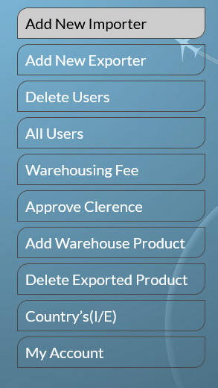
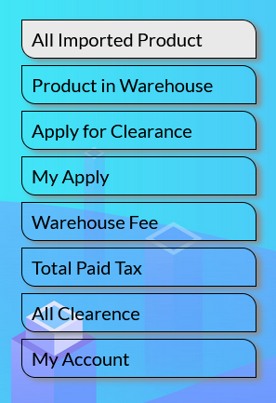
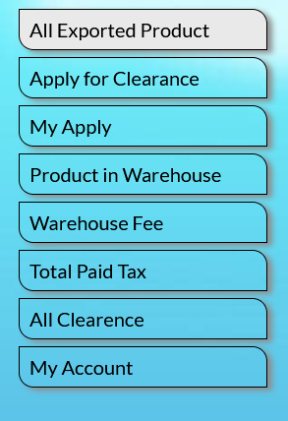
Exporter Panel
Importer Panel
Admin Panel

Slide 5
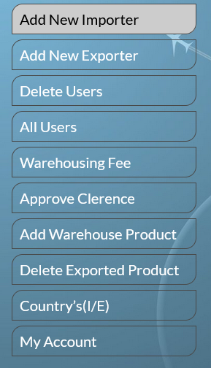
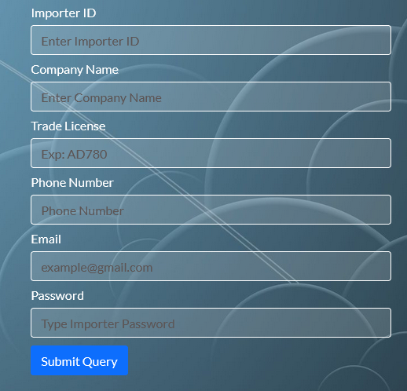
INSERT INTO `importer`(`importer_id`, `company_name`, `trade_license`, `phone`, `email`, `password`) VALUES(?, ?, ?, ?, ?, ?);

Slide 6
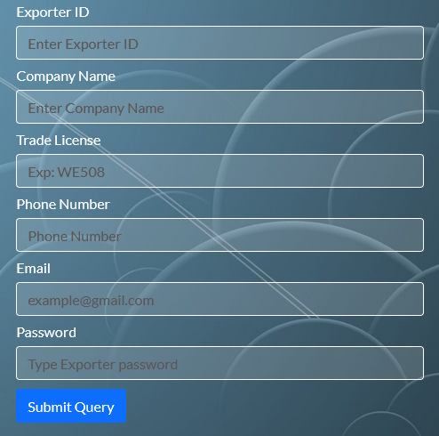
INSERT INTO `exporter`(`exporter_id`, `company_name`, `trade_license`, `phone`, `email`, `password`) VALUES(?, ?, ?, ?, ?, ?);

Slide 7
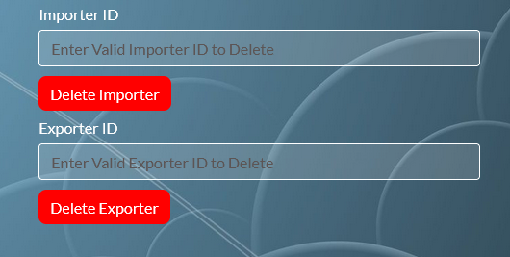
DELETE FROM importer WHERE importer_id = '$delete_importer’;
DELETE FROM exporter WHERE exporter_id = '$delete_exporter’;

Slide 8
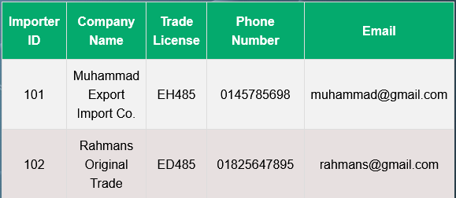
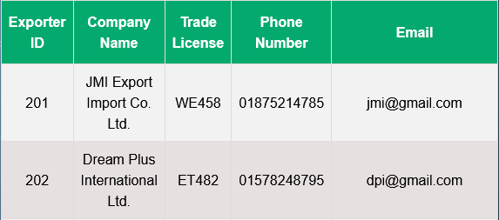
SELECT * FROM importer ORDER BY importer_id ASC;
SELECT * FROM exporter ORDER BY exporter_id ASC;

Slide 9
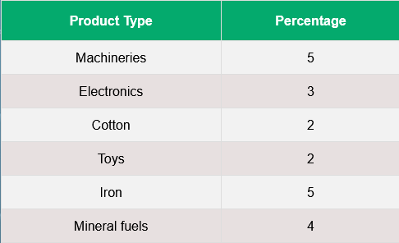
SELECT * FROM warehouse_fee;

Slide 10
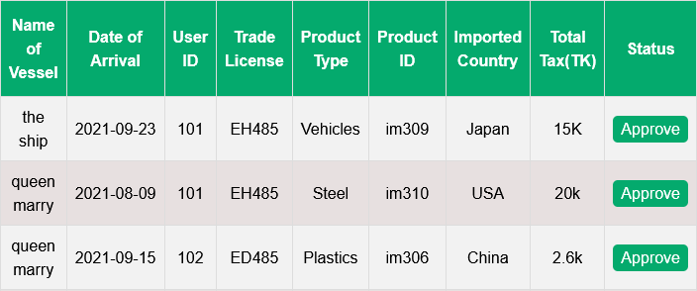
SELECT * FROM apply_for_clearence ORDER BY user_id ASC;

Slide 11
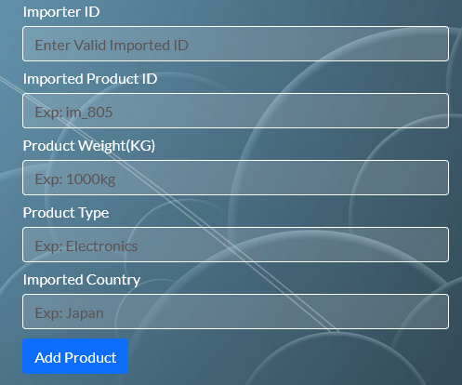
INSERT INTO `im_warehouse`(`importer_id`, `im_product_id`, `product_weight`, `product_type`, `country`) values(?, ?, ?, ?, ?);

Slide 12
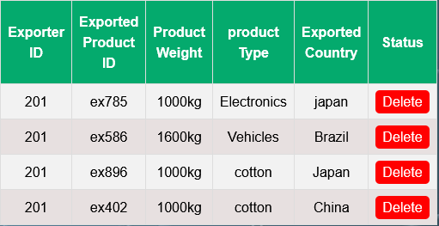
SELECT * FROM `ex_warehouse` ORDER BY exporter_id ASC;
DELETE FROM `ex_warehouse` WHERE exporter_id = '$delete_id';

Slide 13
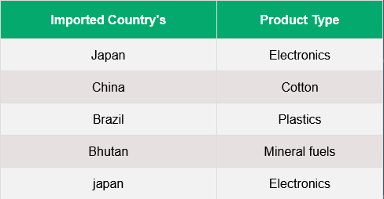
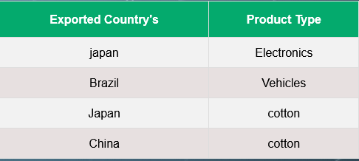
SELECT * FROM imported_country;
SELECT * FROM exported_country ;

Slide 14

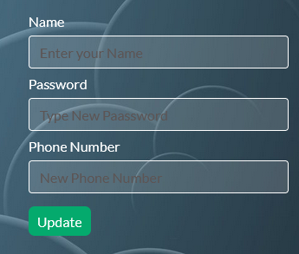
SELECT * FROM `admin` WHERE email = '$admin_email’;
UPDATE admin SET name='$update_name' ,password='$update_password’,
phone='$update_phone' WHERE email = '$admin_email';

Slide 15
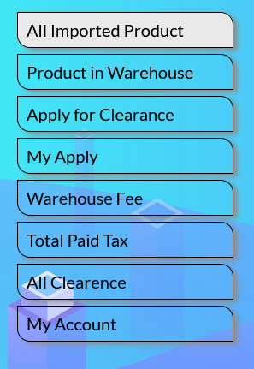
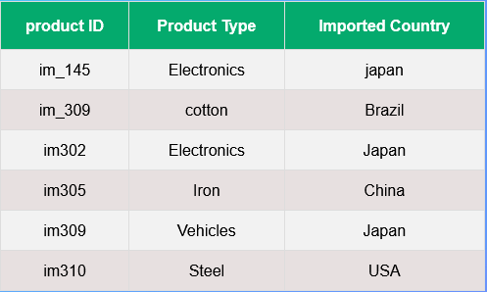
SELECT * FROM `imported_product` WHERE importer_id IN(SELECT importer_id FROM importer WHERE email = '$ importer_email)

Slide 16
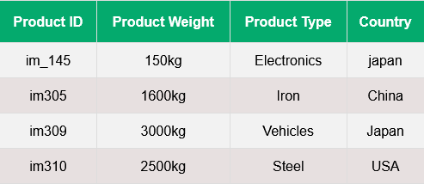
SELECT im_product_id,product_weight,product_type,country FROM im_warehouse WHERE importer_id IN(SELECT importer_id FROM importer WHERE email = '$ importer_email)’;

Slide 17
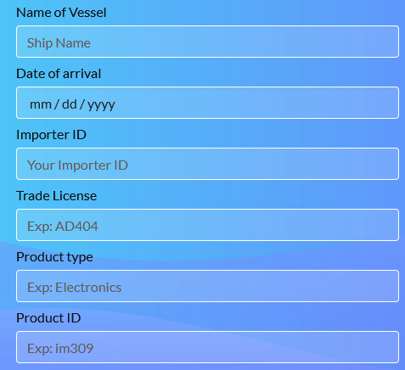
INSERT INTO `apply_for_clearence`(`name_of_vessel`, `date`, `user_id`, `trade_license`, `product_type`, `i_e_product_id`, `product_weight`, `product_weight`, `i_e_country`, `total_tax_amount`) values(?, ?, ?,?, ?, ?, ?,?,?)

Slide 18
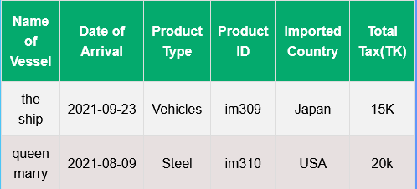
SELECT * FROM `apply_for_clearence` WHERE user_id IN(SELECT importer_id FROM `importer` WHERE email = '$ importer_email);

Slide 19
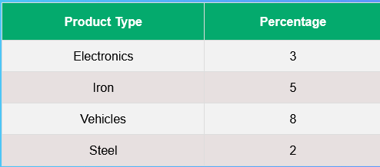
SELECT * FROM `warehouse_fee` WHERE product_type IN(SELECT product_type FROM `im_warehouse` WHERE importer_id IN(SELECT importer_id FROM `importer` WHERE email = '$importer_email'))

Slide 20
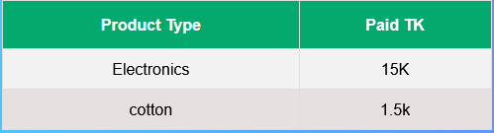
SELECT product_type,total_tax_amount FROM `im_customs_clearance` WHERE importer_id IN(SELECT importer_id FROM `importer` WHERE email ='$importer_email')

Slide 21
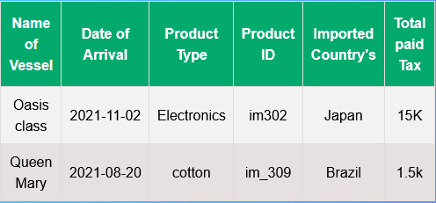
SELECT name_of_vessel,date_of_arrival, product_type, im_product_id, importer_country,total_tax_amount FROM im_customs_clearance WHERE importer_id IN(SELECT importer_id FROM importer WHERE email = '$importer_email')

Slide 22
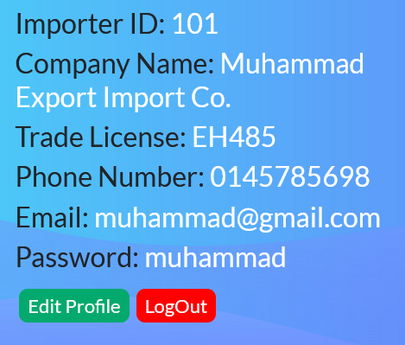
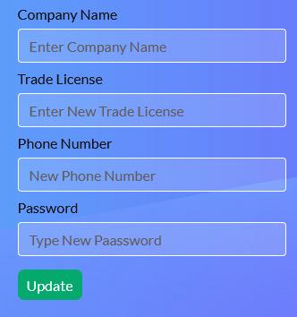
SELECT * FROM importer WHERE email='$importer_email'
UPDATE `importer` SET `company_name`='$company_name', `trade_license`='$trade_license', `phone`='$update_phone', `password`='$update_password' WHERE email = '$importer_email'

Slide 23
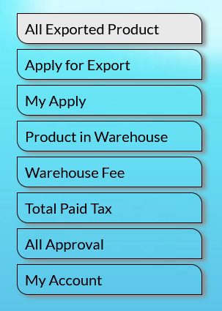
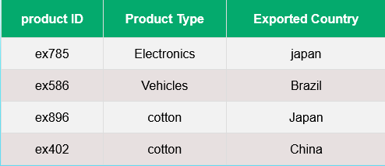
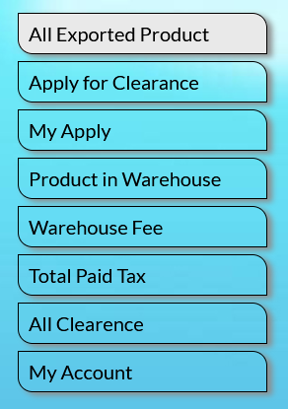
SELECT * FROM `exported_product` WHERE exporter_id IN(SELECT exporter_id FROM exporter WHERE email = '$exporter_email')

Slide 24
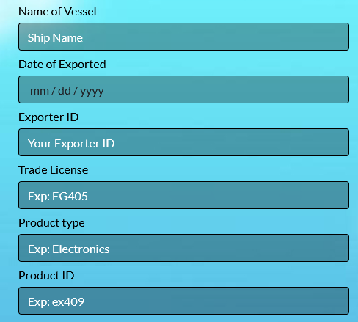
INSERT INTO `apply_for_clearence`(`name_of_vessel`, `date`, `user_id`, `trade_license`, `product_type`, `i_e_product_id`,`product_weight`, `i_e_country`, `total_tax_amount`) values(?, ?, ?,?, ?, ?, ?,?,?);

Slide 25
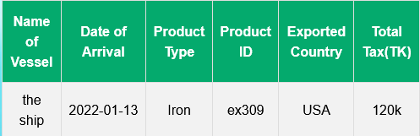
SELECT * FROM `apply_for_clearence` WHERE user_id IN(SELECT exporter_id FROM `exporter` WHERE email = '$exporter_email')

Slide 26
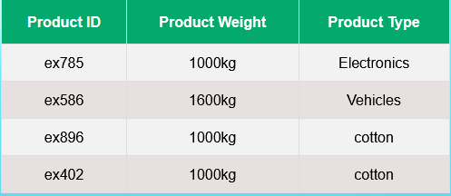
SELECT ex_product_id,product_weight,product_type FROM ex_warehouse WHERE exporter_id IN(SELECT exporter_id FROM exporter WHERE email = '$exporter_email’);

Slide 27
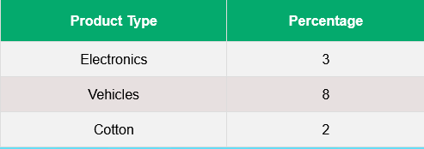
SELECT * FROM `warehouse_fee` WHERE product_type IN(SELECT product_type FROM `ex_warehouse` WHERE exporter_id IN(SELECT exporter_id FROM `exporter` WHERE email = '$exporter_email'))

Slide 28
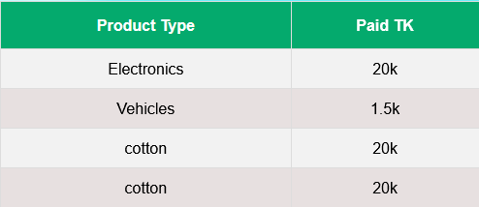
SELECT product_type,total_tax_amount FROM `ex_customs` WHERE exporter_id IN(SELECT exporter_id FROM `exporter` WHERE email ='$exporter_email')

Slide 29
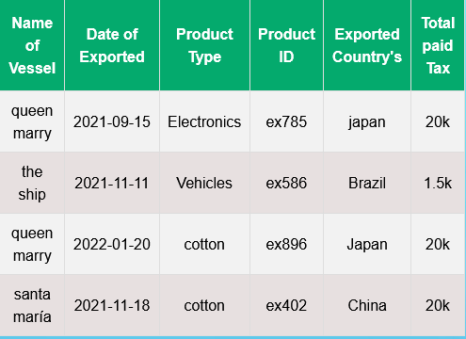
SELECT name_of_vessel,date_of_exported,product_type, ex_product_id,exporter_country,total_tax_amount FROM ex_customs WHERE exporter_id IN(SELECT exporter_id FROM exporter WHERE email = '$exporter_email')

Slide 30
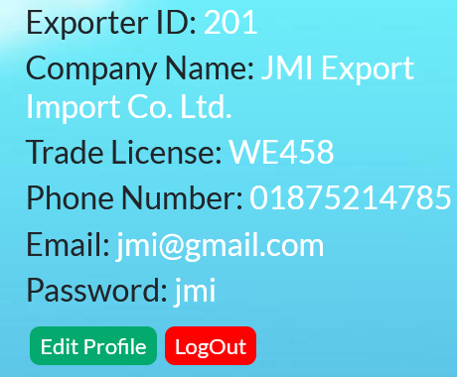
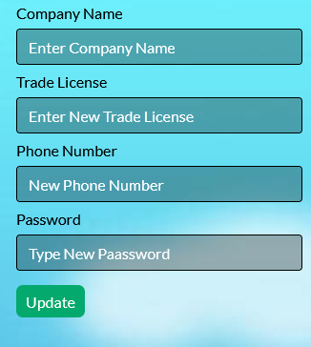
SELECT * FROM exporter WHERE email='$exporter_email'
UPDATE `exporter` SET `company_name`='$company_name’,`trade_license`=
'$trade_ license',`phone`='$update_phone',`password`='$update_password’
WHERE email = '$exporter_email'

Slide 31
Thank you Everyone

